Slide 2
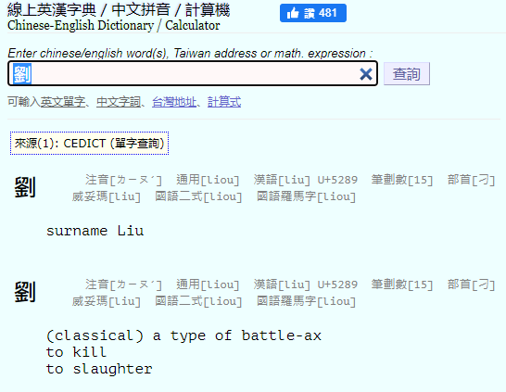

Slide 3
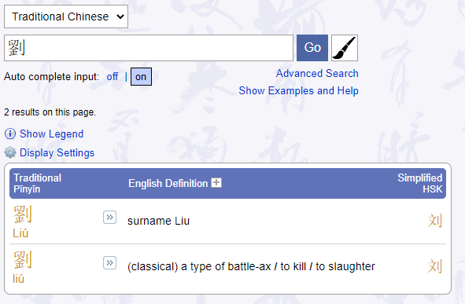
https://www.mdbg.net/chinese/dictionary
Ax, to kill, to slaughter

Slide 4
劉
Ax, to kill, to slaughter
surname Liu
"Han dynasty" and "House of Liu"
Or
Ax, to kill, to slaughter
劉
English description
Hanzi

Slide 5

Radical "Bushu"
字根(root)、字首(prefix)、字尾(suffix)
In the traditional Chinese character 媽 mā "mother", the left part is the radical 女 nǚ "female". It is the semantic component of a phono-semantic compound (形聲字), disambiguating the right part, 馬 mǎ "horse", the phonetic component.
https://en.wikipedia.org/wiki/Radical_(Chinese_characters)

Slide 6
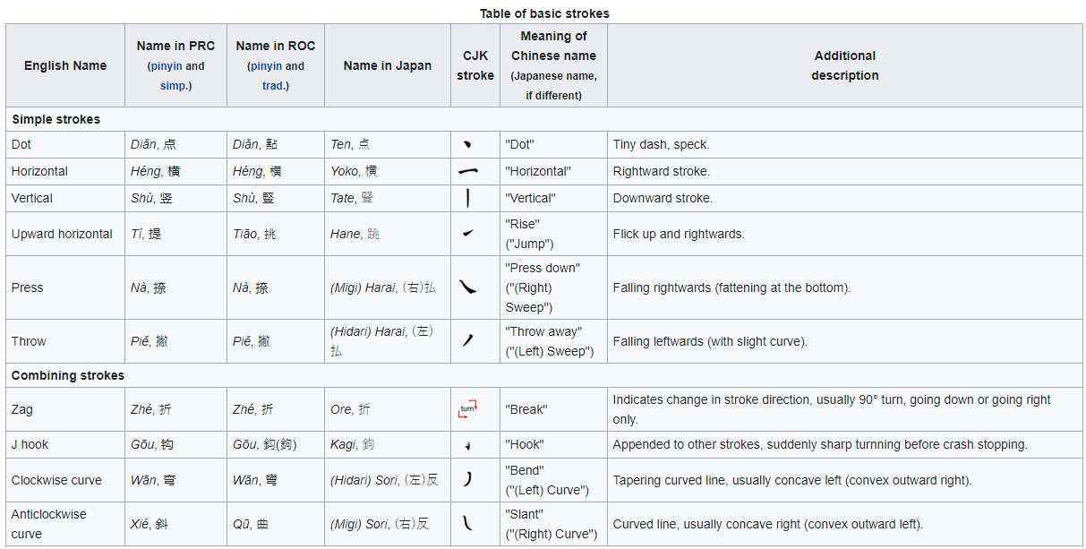
Stroke (Handwriting)
https://en.wikipedia.org/wiki/Stroke_(CJK_character)

Slide 7
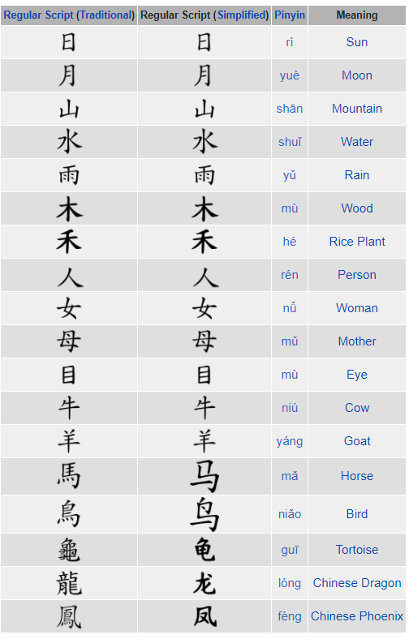
Chinese character classification
Pictograms
Simple ideograms
Compound ideographs
Rebus (phonetic loan) characters
Phono-semantic compound characters
https://en.wikipedia.org/wiki/Chinese_character_classification#Modern_classifications

